Slide 1

DeepLearning
Architectures and Use Cases
The Cloud Data Platform for Insights-Driven Enterprises

Slide 2
Computer Vision

Slide 3
Convolution Neural Network (CNN/Covnets)
Convolution Neural Network
Break Through Architecture to start Deep Learning Disruption.
Very Successfully in Images and Video datasets
Also Used in Text Classification and other use cases

Slide 4
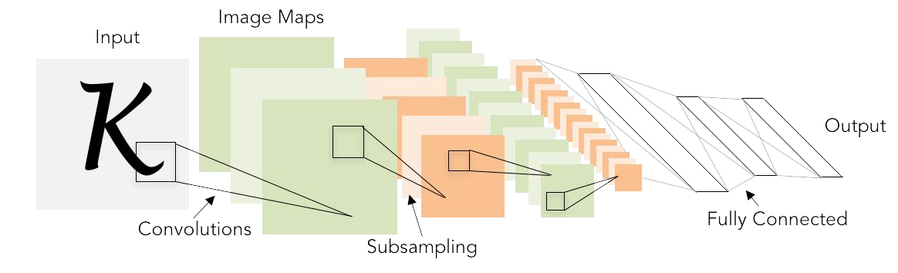
Convolution Neural Network Architecture

Slide 5

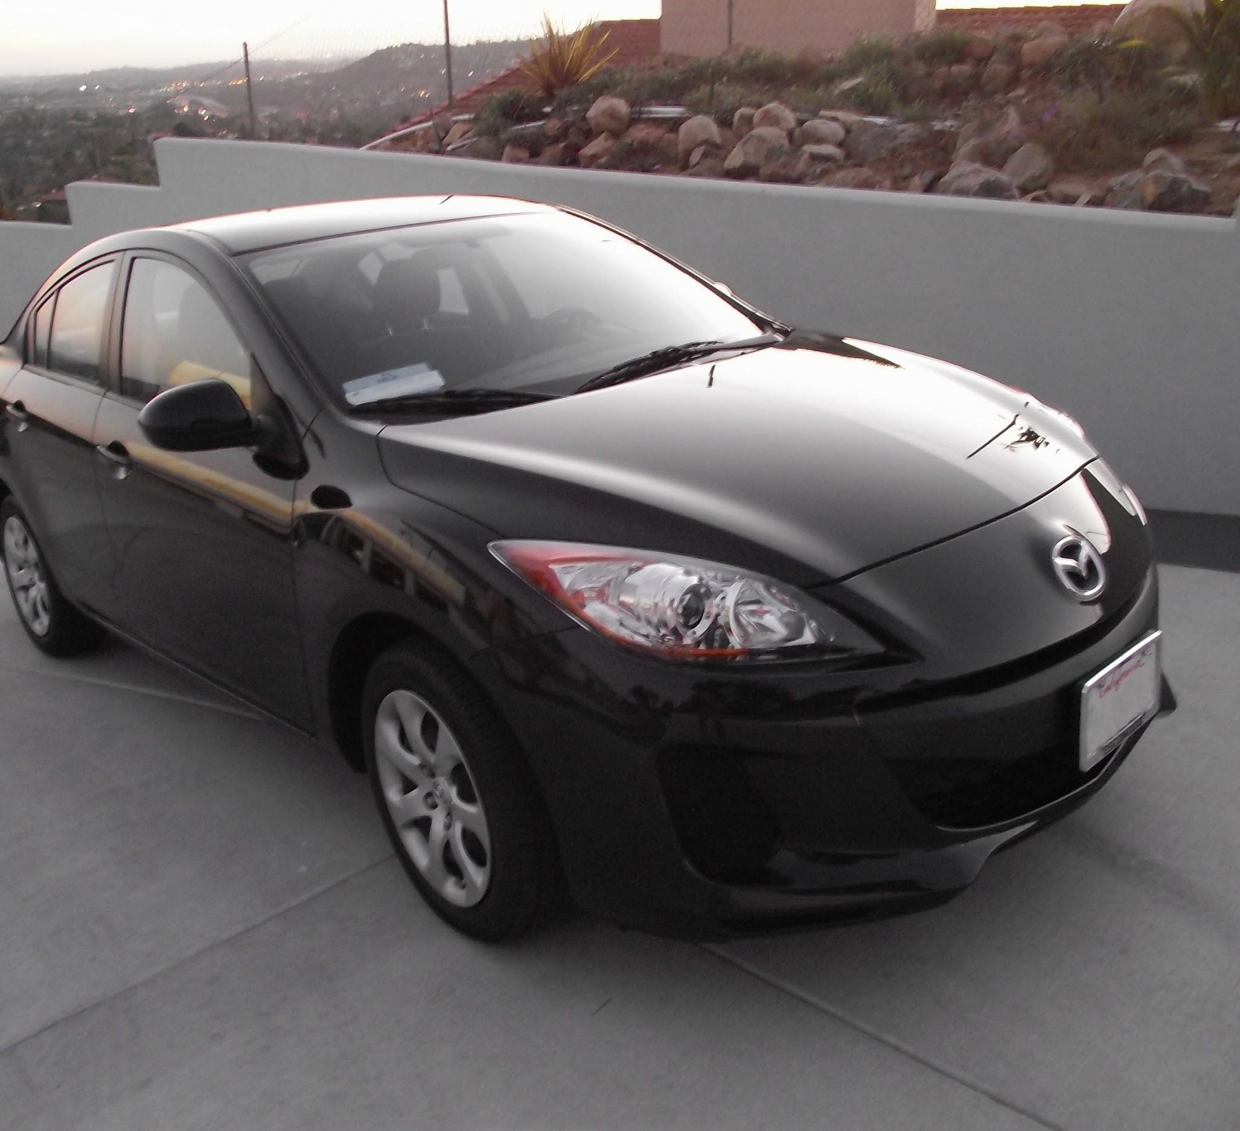
Convolution Neural Network

Slide 6
Image Classification – CNN Models

Slide 7
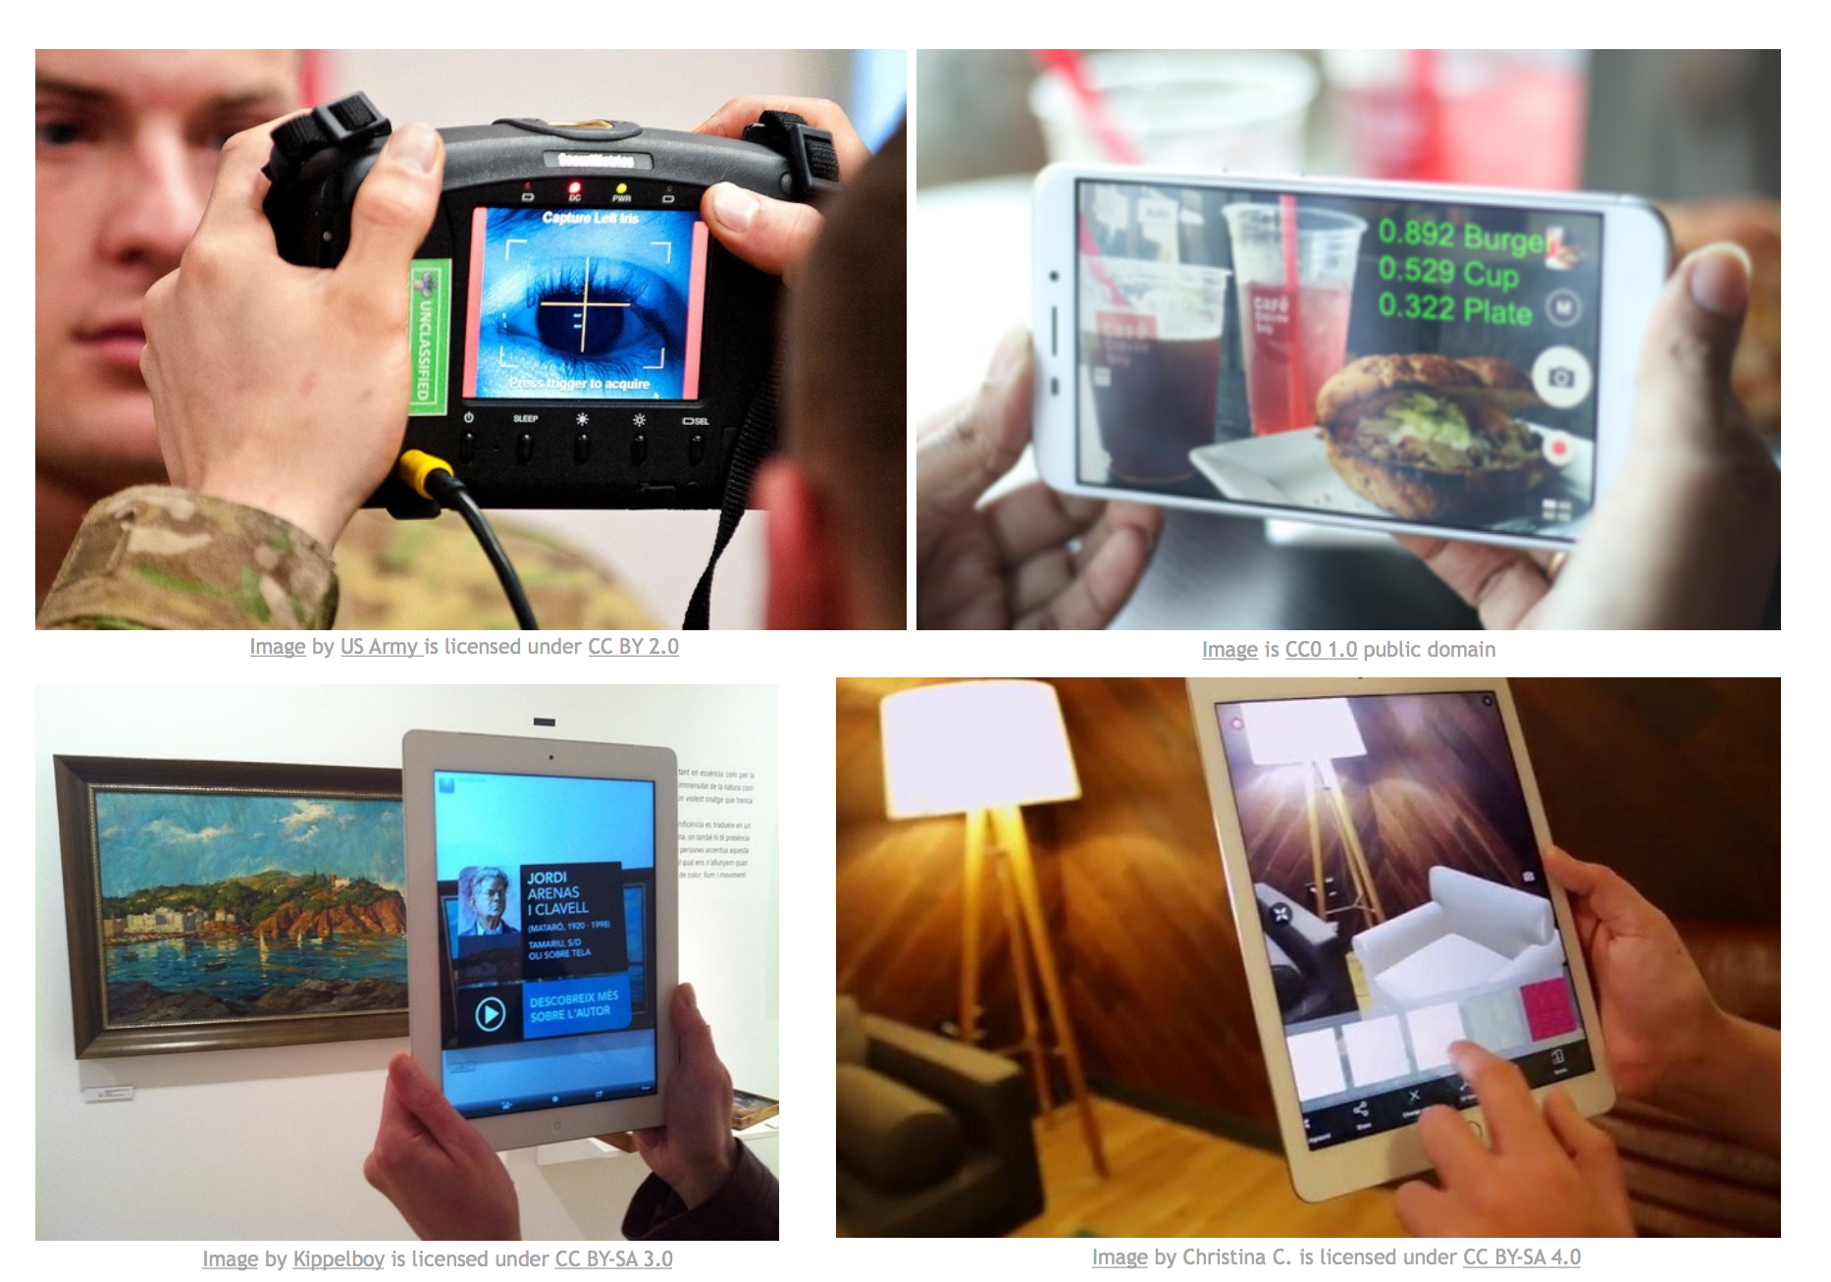
Cameras can See?

Slide 8
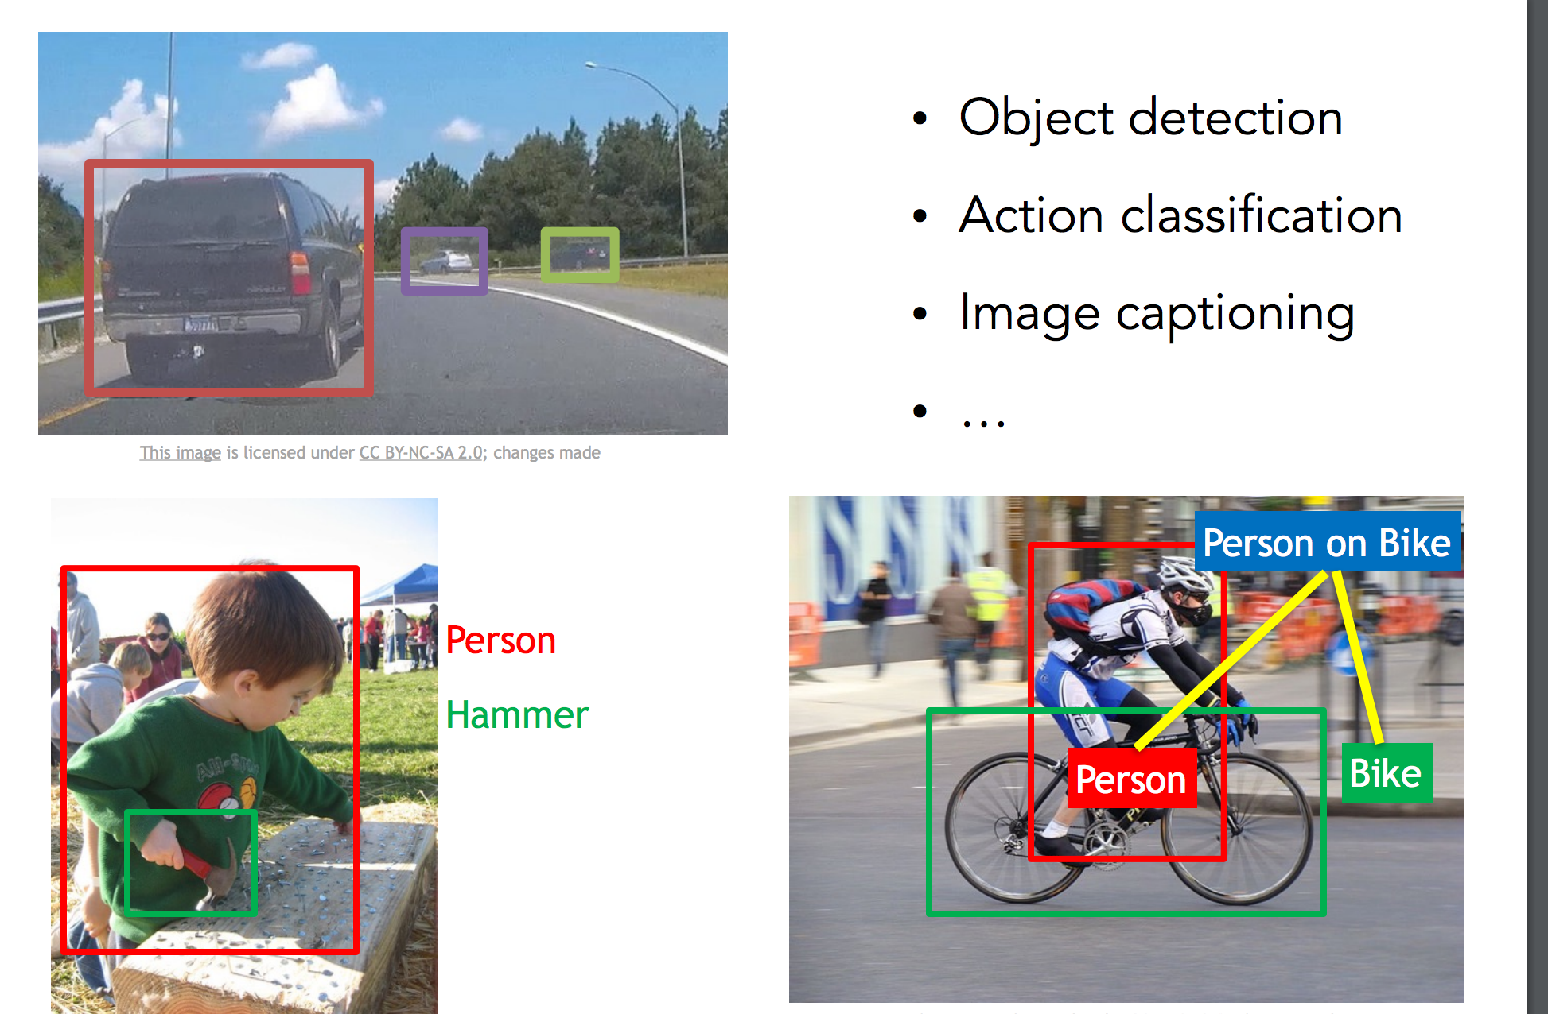
Image Segmentation

Slide 9
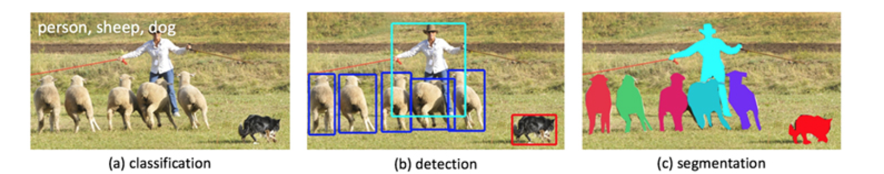
Image Classification/Detection/Segmentation

Slide 10
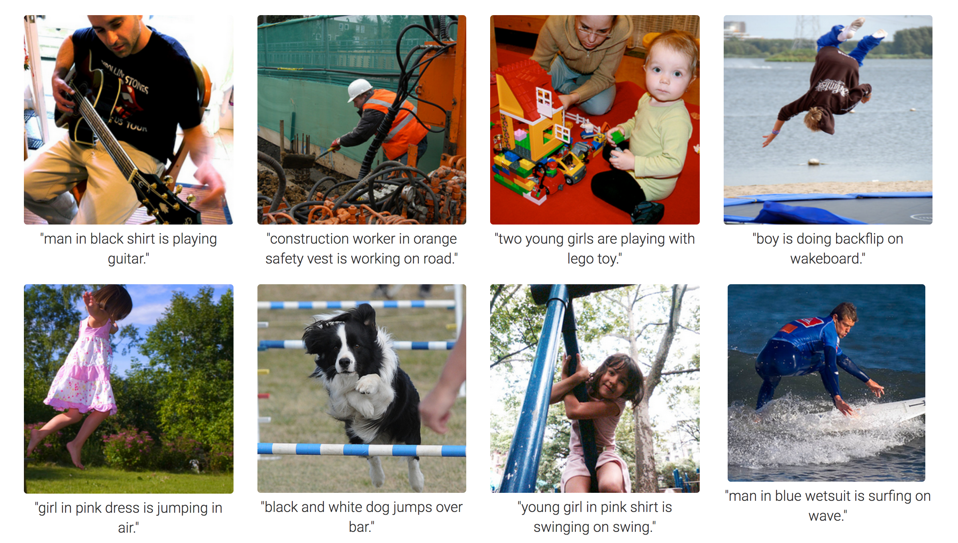
Image to Text
CNN and RNN (Recurral Neural Networks)

Slide 11
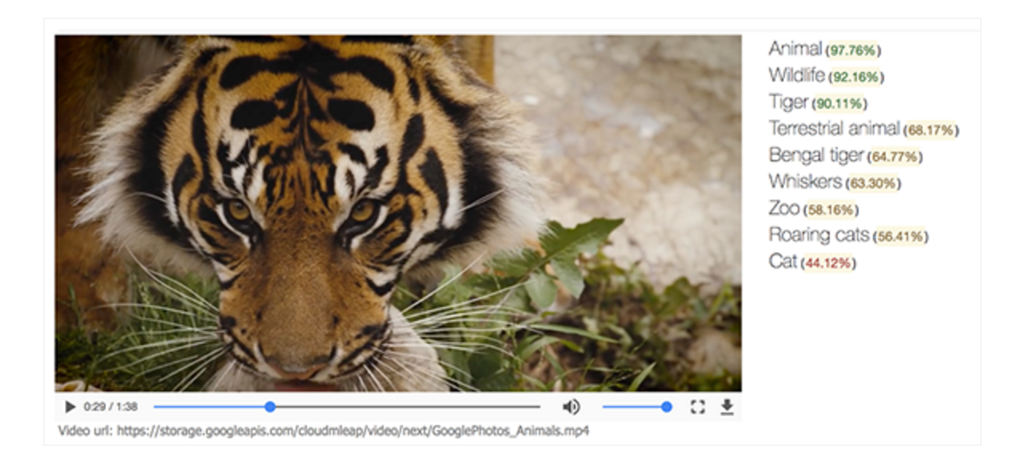
Video to Text

Slide 12
Neural Styles

Slide 13
Generative Adversarial Network

Slide 14
Generative Adversarial Network
Revolutionary Research in Modern Deep Learning
Networks Trained with Generated Data and Real Data
Generated Data is labelled as fake
Real Data is trained are real
One Network is called Generative and the other Discriminative
Eventually after enough training, Generative Network generates realistic data, that the network has not seen before.

Slide 15
Generative Adversarial Network - Architecture

Slide 16
Generative Adversarial Networks – Bedroom Output

Slide 17
Sequence Analysis

Slide 18
Recurrent Neural Networks

Slide 19
Natural Language Processing
Machine Translation
Higher Accuracy
Same Model can do multi-language translation without pre-training on every language
Question Answer System
Word Embeddings
Sentence Completions
Speech to Text (Siri)
Text to Speech
Text Summarization

Slide 20
Natural Language Processing
Copying Voice and Accents
WaveNets

Slide 21
Self Driving Car

Slide 22
Nvidia – Self Driving Car

Slide 23
Mapping for Self Driving Cars

Slide 24
Reinforcement Learning

Slide 25
Reinforcement Learning

Slide 26
Deep Reinforcement Learning

Slide 27
Finance and Advertisement
Futures and Stocks
Learning from User Behavior to Predict very accurate Advertisements

Slide 28


